Slide 1

Grasshopper V5
For

Slide 2
Where is Grasshopper today?

Slide 3
Free

Slide 4

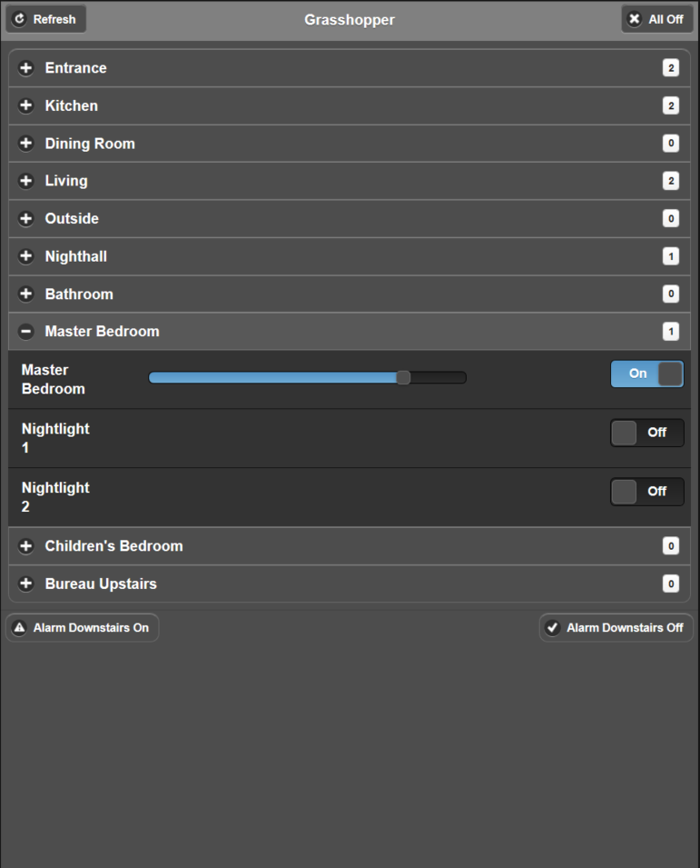
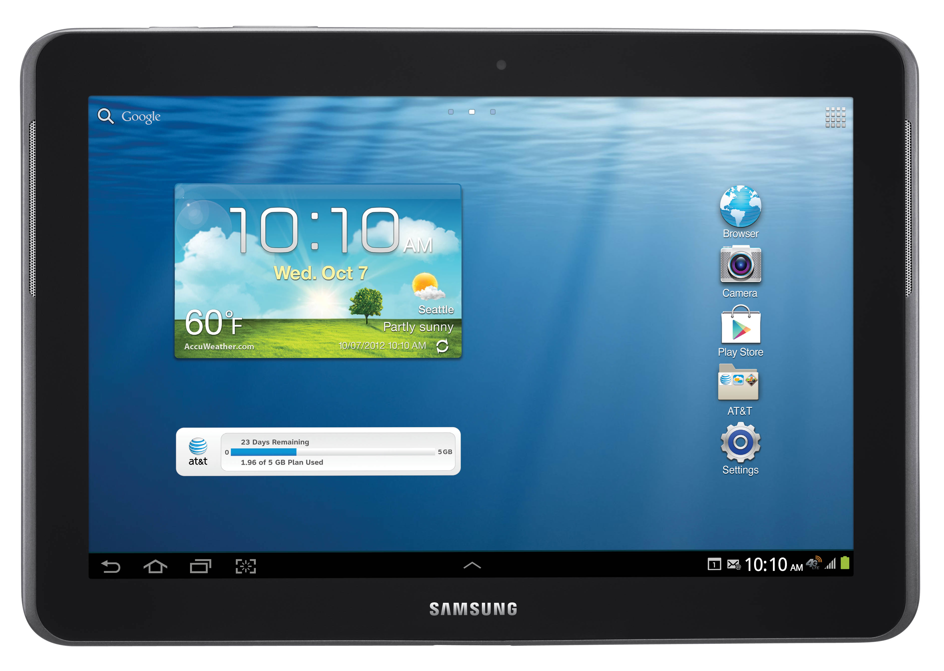
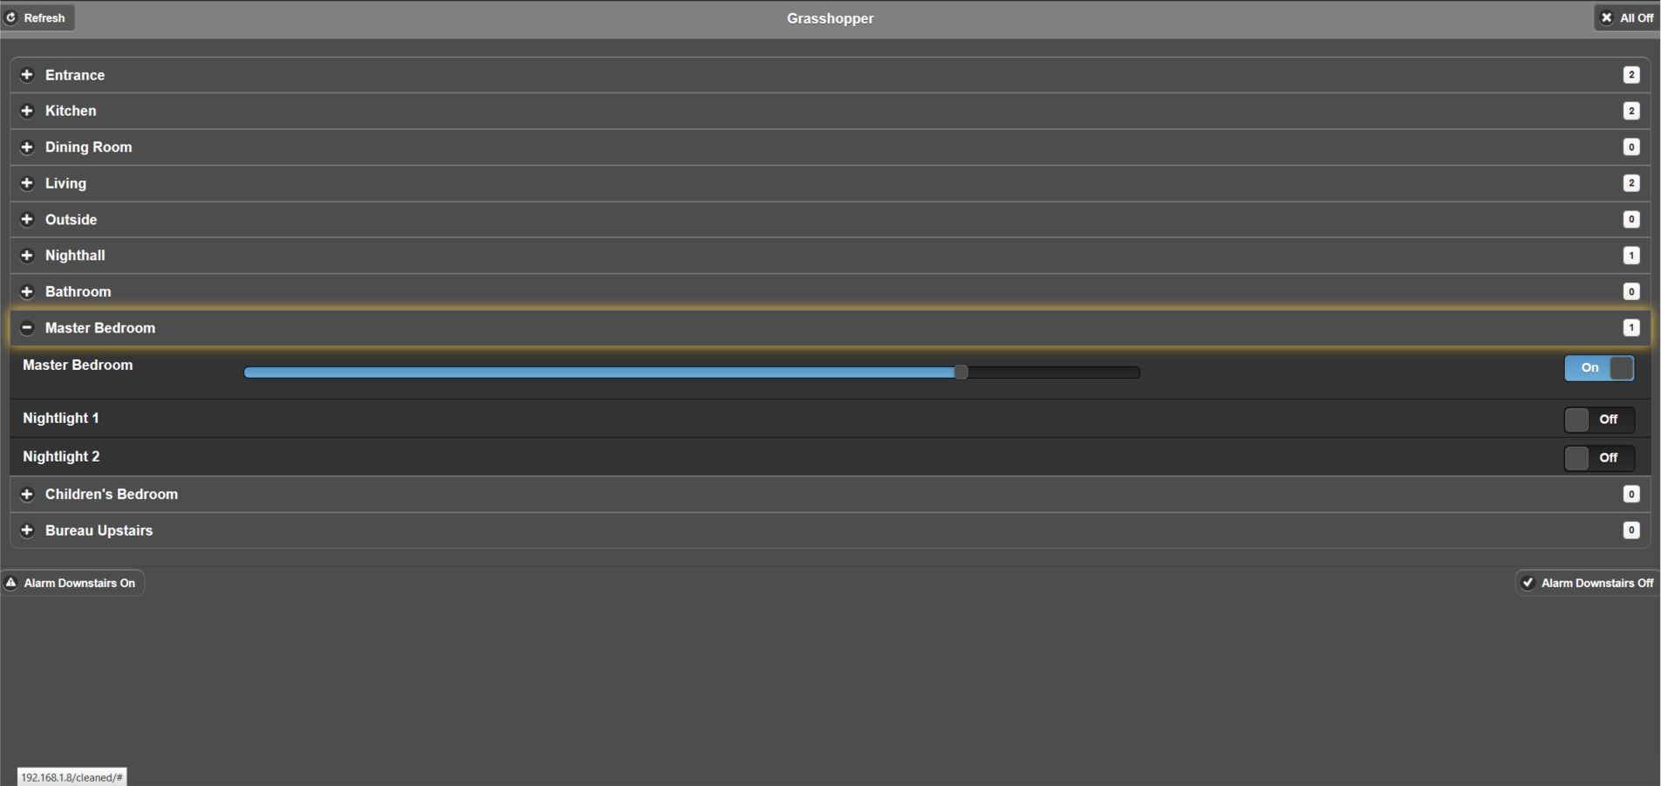
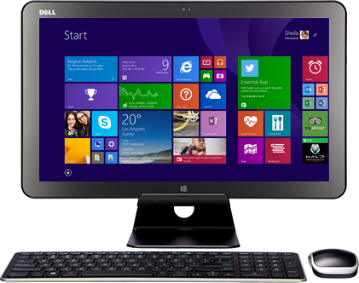
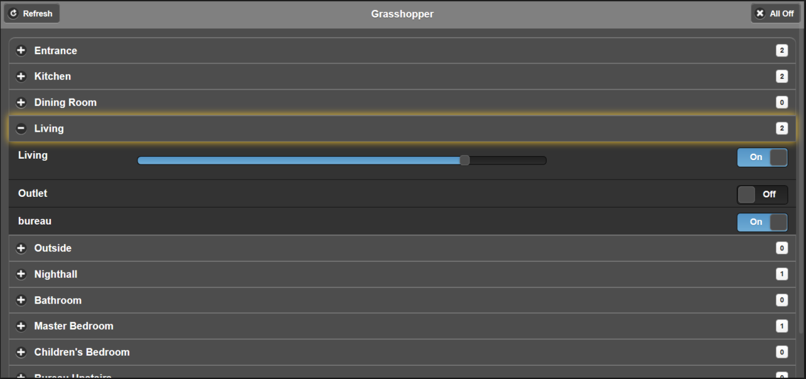
What does Grasshopper offer?
1.

Slide 5
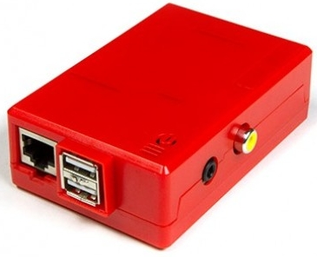
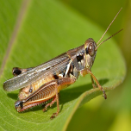


What does Grasshopper offer?
1.
2.
3.

Slide 6
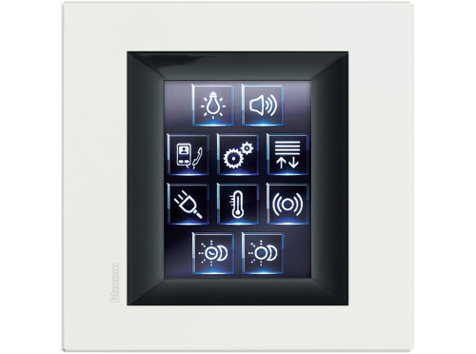
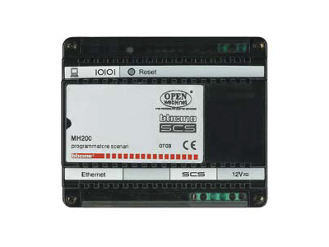
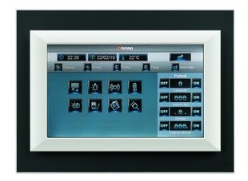
What does Grasshopper offer?
1.
2.
3.
4.

Slide 7
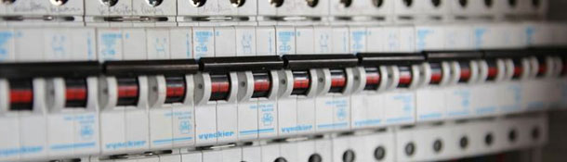
What does Grasshopper offer?
1.
2.
3.
4.
5.

Slide 8
What does Grasshopper offer?
1.
2.
3.
4.
5.

Slide 9
What does Grasshopper offer?
1.
2.
3.
4.
5.

Slide 10
What does Grasshopper offer?
1.
2.
3.
4.
5.

Slide 11
My wife is a
I’m not saying my wife is stupid…..
she just isn’t that good with computers
However, she did manage to
install and configure Grasshopper V5
in under 40 minutes

